Slide 1
Hough Transform
COMP 4900C
Winter 2008

Slide 2
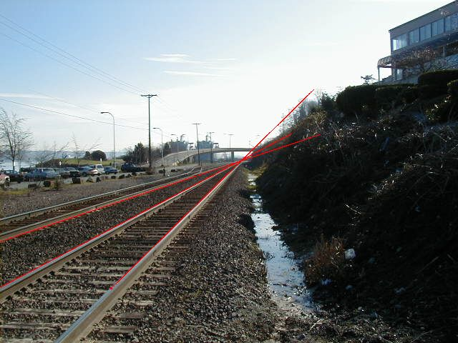
Lines

Slide 3
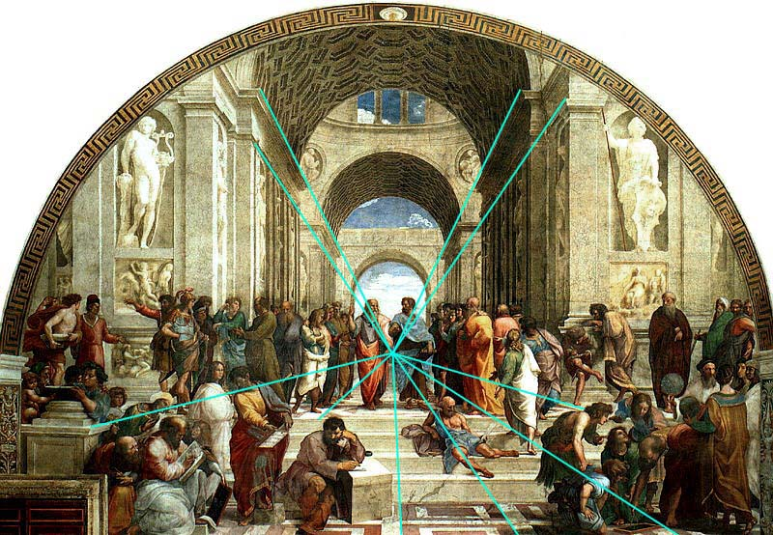
Lines
Rafael, The School of Athens (1518)

Slide 4
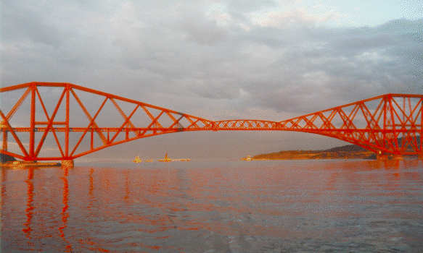
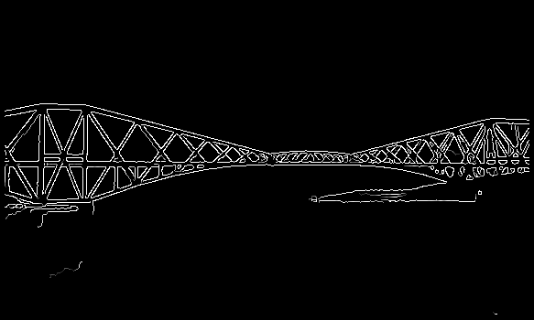
Line Detection
The problem:
How many lines?
Find the lines.

Slide 5
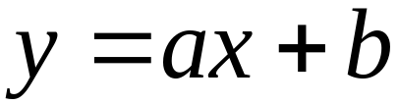
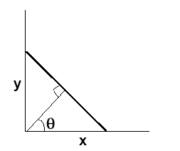
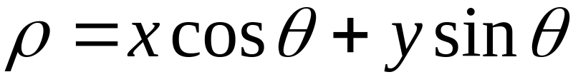
Equations for Lines
The slope-intercept equation of line
What happens when the line is vertical? The slope a goes
to infinity.
A better representation – the polar representation
ρ

Slide 6
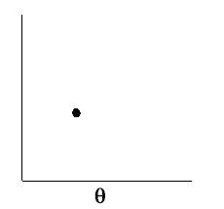
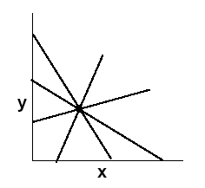
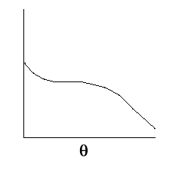
Hough Transform: line-parameter mapping
A line in the plane maps to a point in the θ-ρ space.
ρ
(θ,ρ)
ρ
All lines passing through a point map to a sinusoidal curve in the
θ-ρ (parameter) space.
ρ

Slide 7
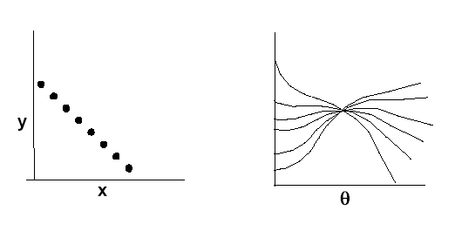
Mapping of points on a line
ρ
Points on the same line define curves in the parameter space
that pass through a single point.
Main idea: transform edge points in x-y plane to curves in the
parameter space. Then find the points in the parameter space
that has many curves passing through.

Slide 8


Quantize Parameter Space
m
m
Detecting Lines by finding maxima / clustering in parameter space.

Slide 9
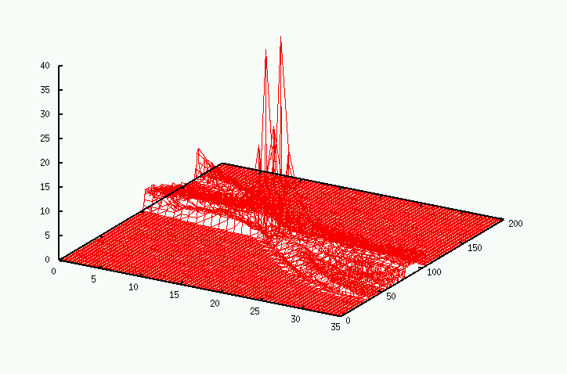
Parameter space – 3D view

Slide 10
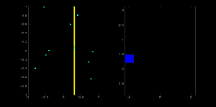
A Voting Scheme

Slide 11
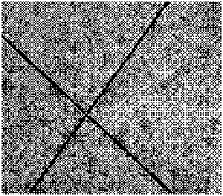
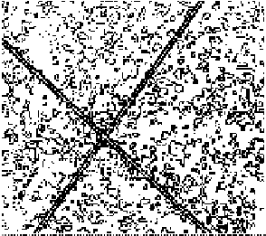

Examples
Image
Edge detection
Hough Transform

Slide 12

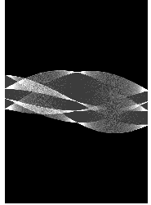
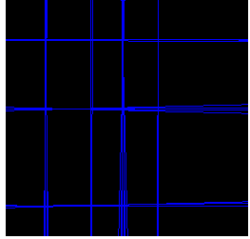

Examples
input image
Hough space
lines detected

Slide 13
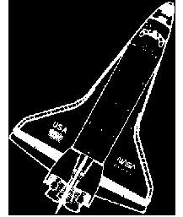
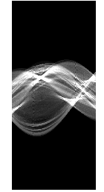
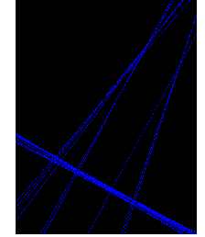
Examples
input image
Hough space
lines detected
  Image credit: NASA Dryden Research Aircraft Photo Archive

Slide 14
Algorithm
Quantize the parameter space
int P[0, ρmax][0, θmax]; // accumulators
2. For each edge point (x, y) {
For (θ = 0; θ <= θmax; θ = θ+Δθ) {
// round off to integer
(P[ρ][θ])++;
}
}
3. Find the peaks in P[ρ][θ].

Slide 15
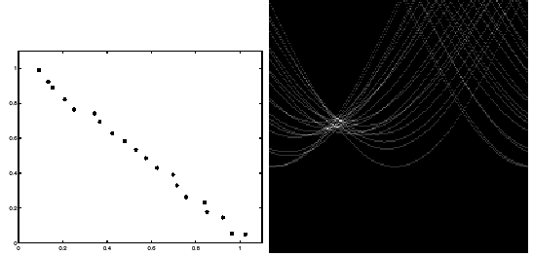
Cell Size
Choose the parameter cell size such that the algorithm is robust
to noise.

